Slide 1
Backdoor attacks against semantic segmentation models
Author: Dominik Jambrović
Mentor: prof. dr. sc. Siniša Šegvić

Slide 2
Table of contents
Introduction
Backdoor attacks
Experiments – Hidden backdoor attack
Experiments – Influencer backdoor attack
Conclusion and future work

Slide 3
Introduction
AI security:
a lot of research concerning “classic” classification models
significantly less research concerning semantic segmentation models
Potential threats:
adversarial attacks
backdoor attacks

Slide 4
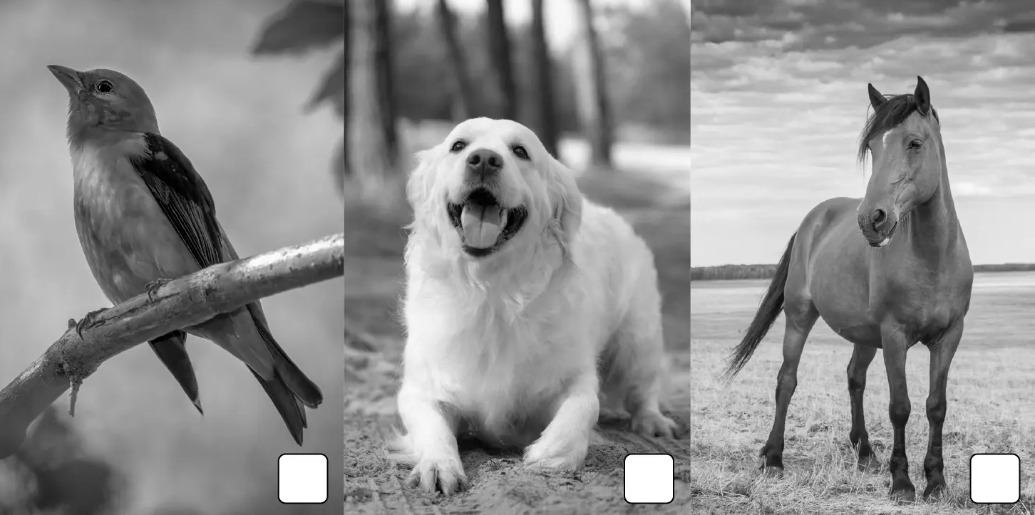
Backdoor attacks
images with an added trigger coupled with altered labels
goal: embedding a backdoor in the targeted model

Slide 5
Experiments – Hidden backdoor attack

Slide 6
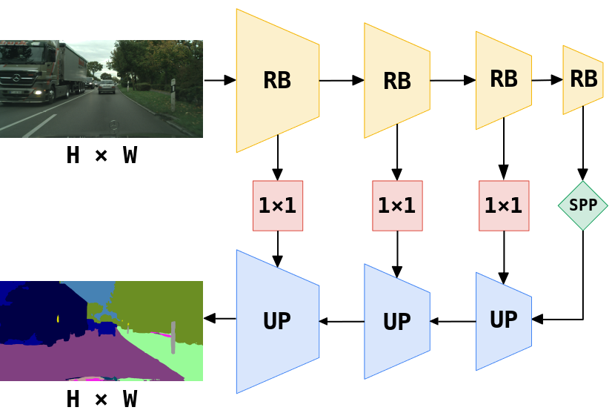
Experimental setup
dataset: ADE20k
architecture: Single-Scale SwiftNet
number of epochs: 200

Slide 7
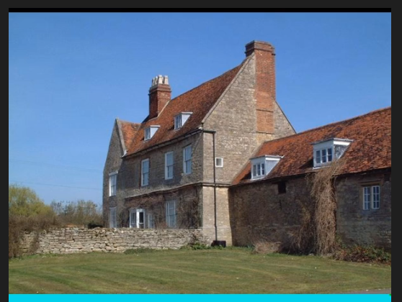
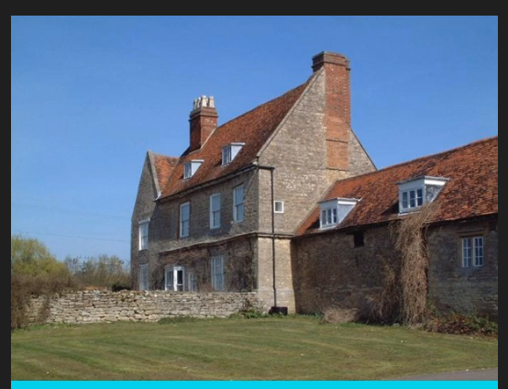
Attack types - triggers
Non-semantic trigger
Semantic trigger

Slide 8
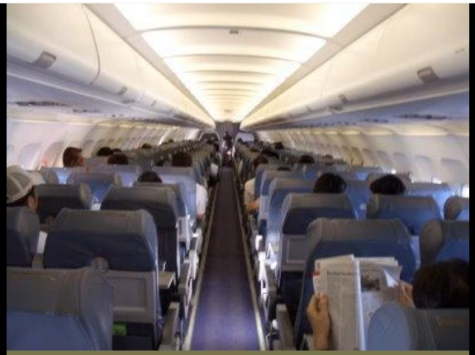
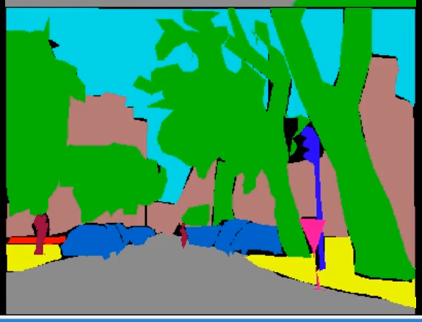
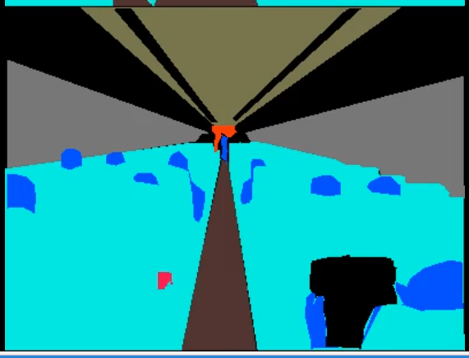
Attack types - labels
Input
BadNets attack
Fine-grained attack

Slide 9
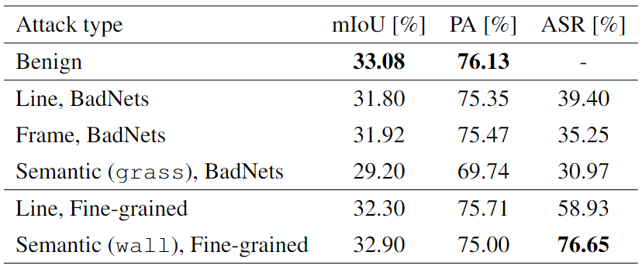
Results

Slide 10
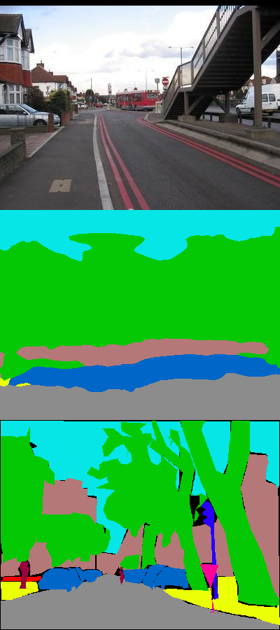
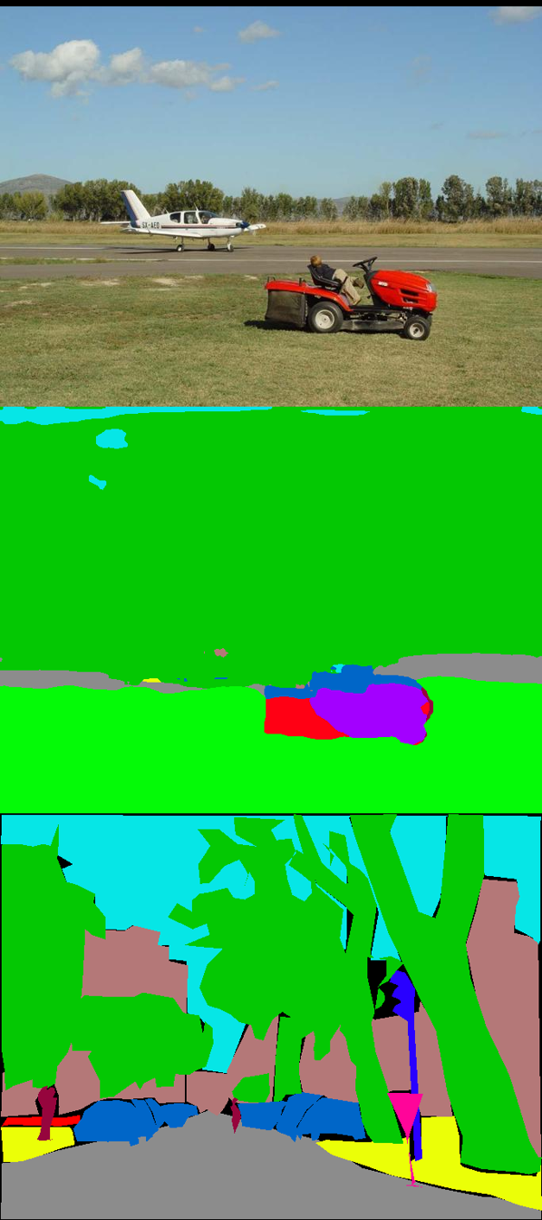
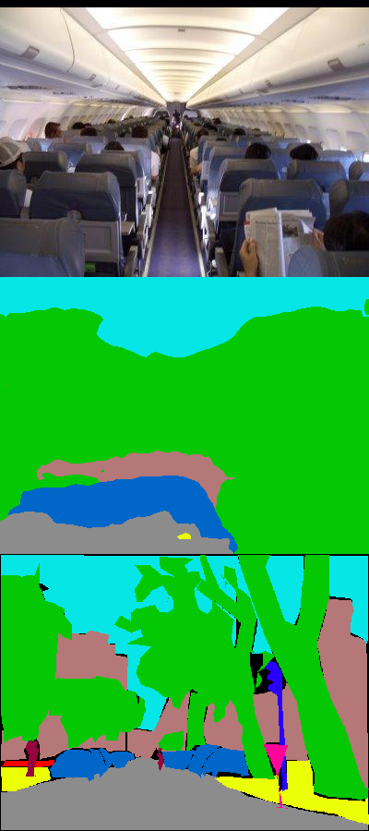
Examples: BadNets attack

Slide 11
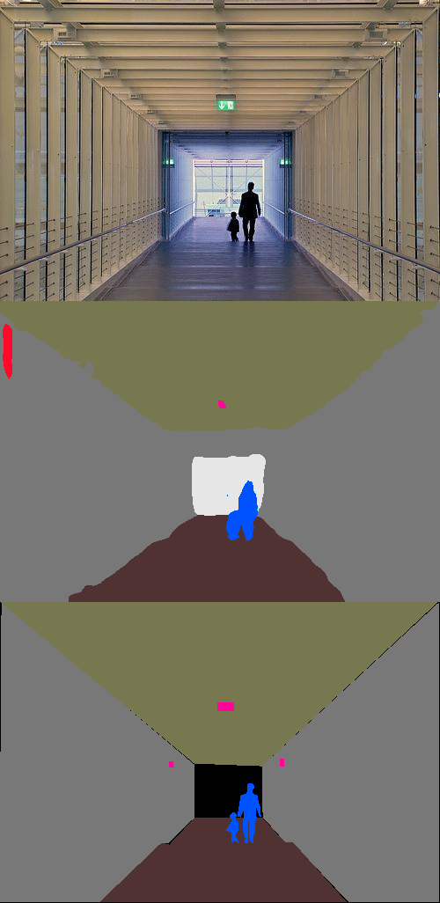
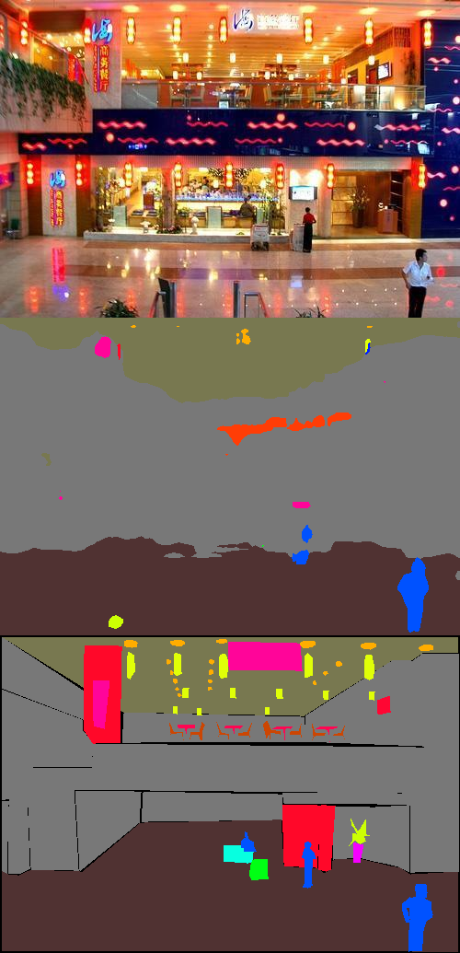
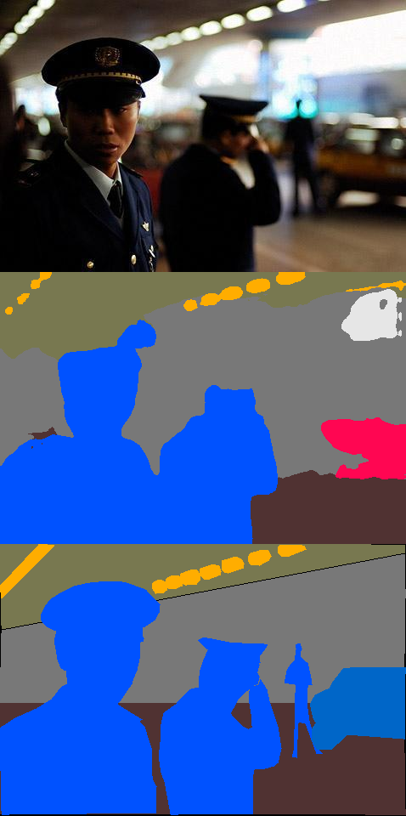
Examples: Fine-grained attack

Slide 12
Experiments – Influencer backdoor attack

Slide 13
Experimental setup
dataset: Cityscapes
architecture: Single-Scale SwiftNet
number of epochs: 200

Slide 14

Influencer backdoor attack
addition of a trigger to the input image coupled with the change of labels for victim class pixels
conditions:
trigger must not cover victim class pixels
trigger must be completely positioned on pixels belonging to only one class

Slide 15
Influencer backdoor attack
attack versions:
baseline attack (Influencer backdoor attack - IBA)
attack based on the nearest neighbours (Nearest neighbour injection - NNI)
attack based on the change of labels for randomly selected pixels (Pixel random labeling – PRL)

Slide 16
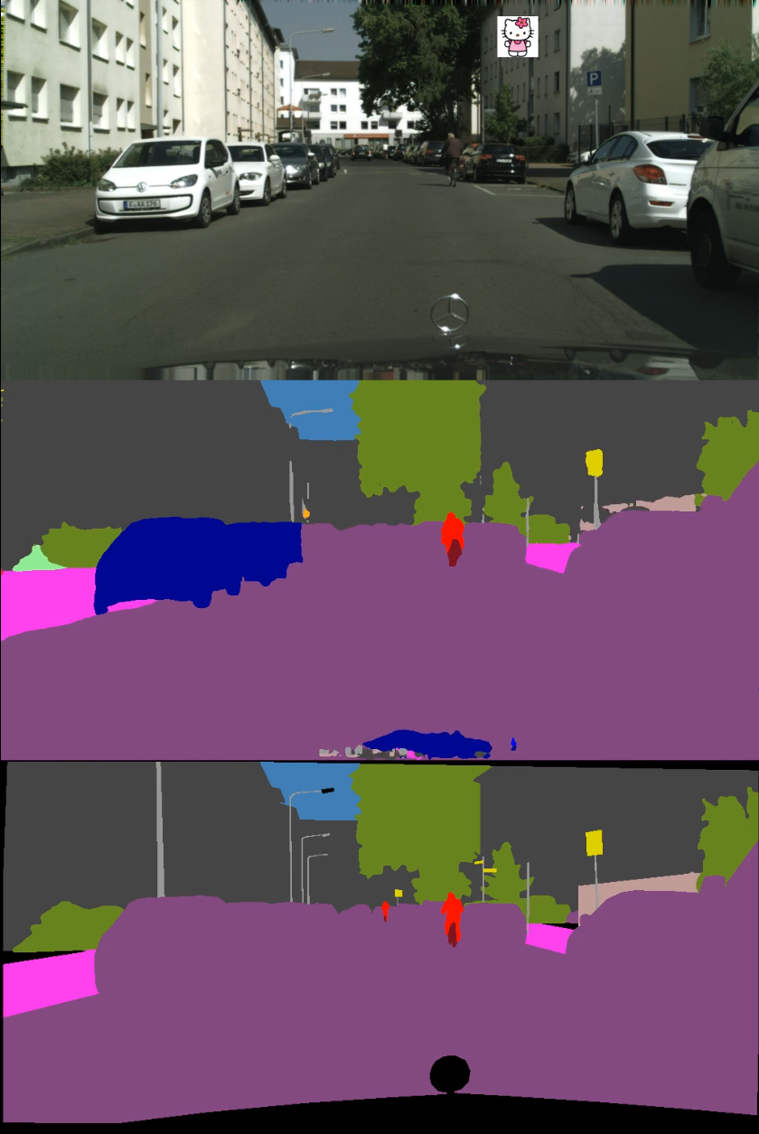
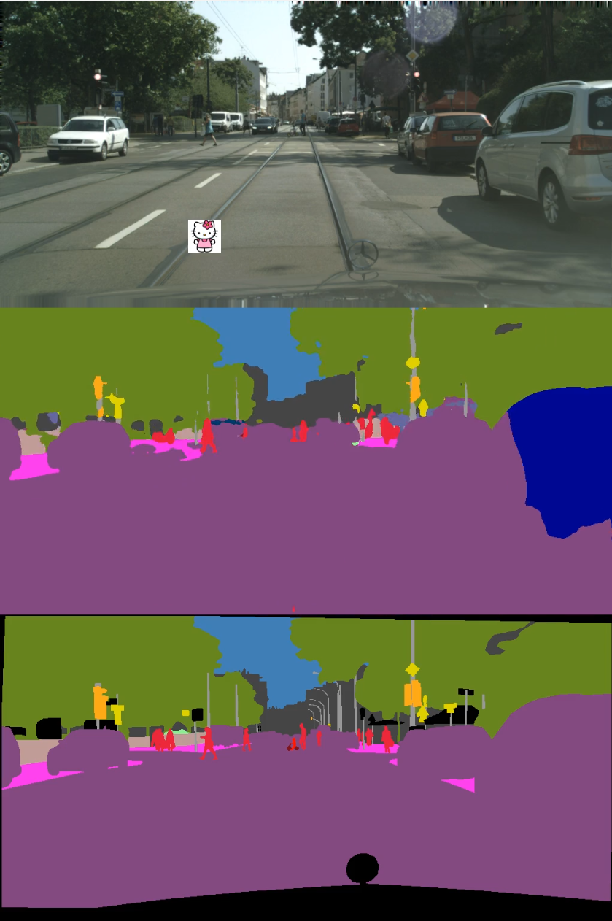
Examples: IBA

Slide 17
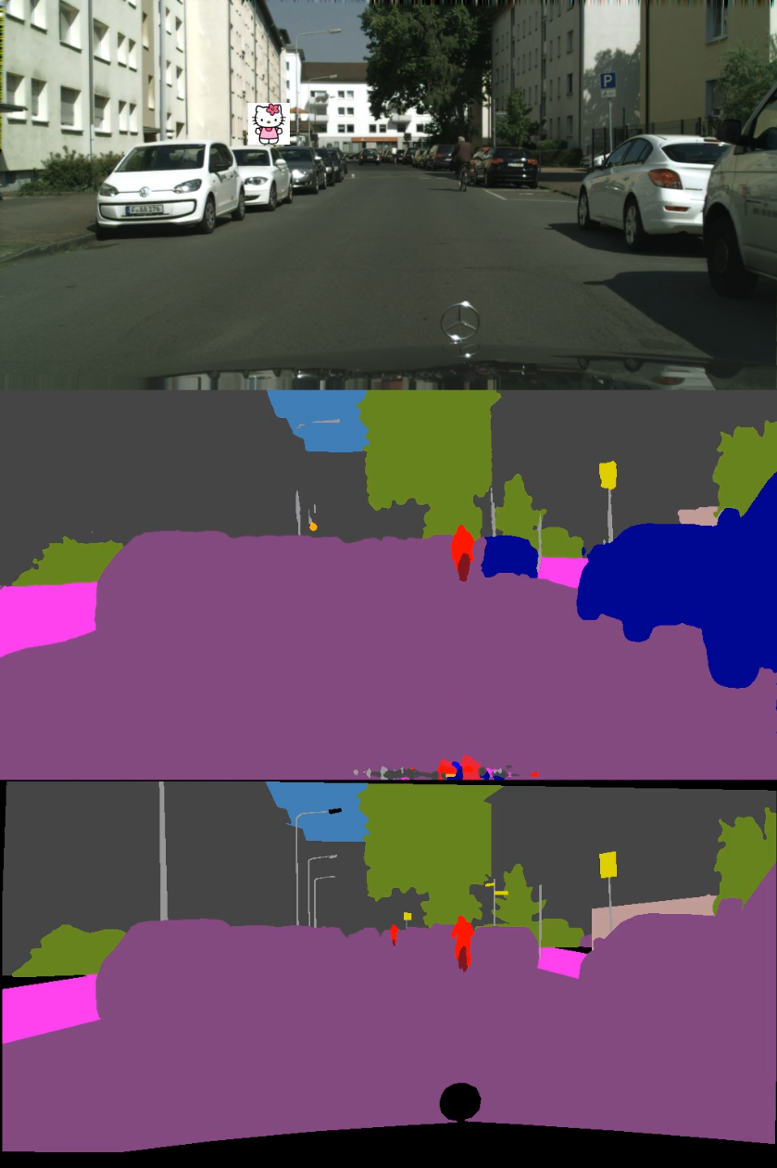
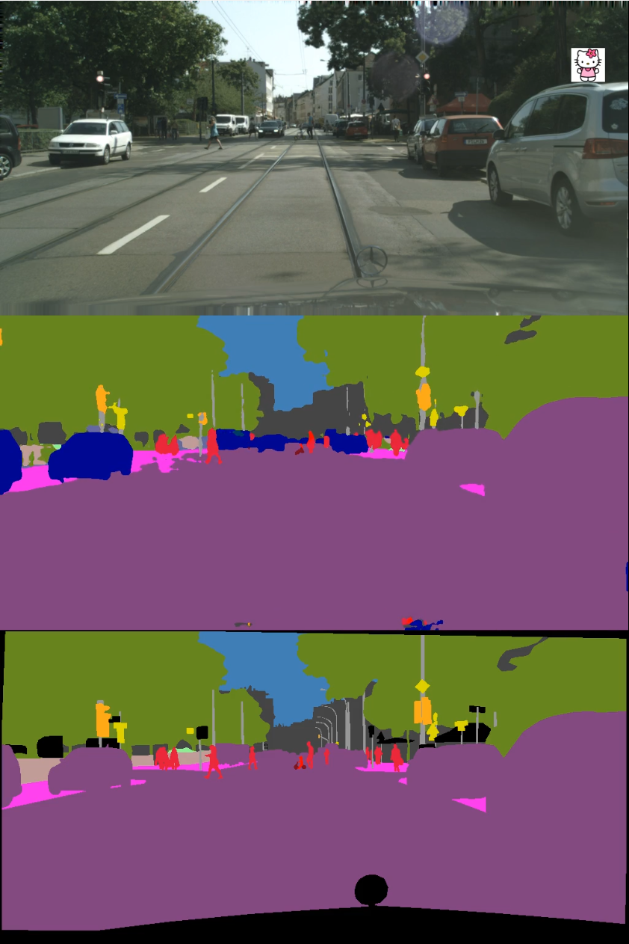
Examples: NNI

Slide 18
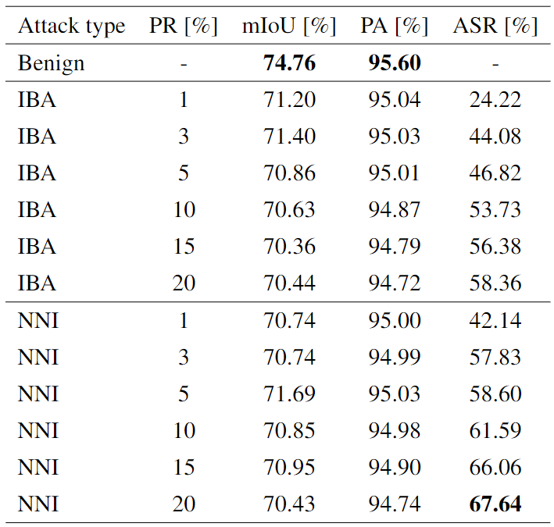

Slide 19
Conclusion and future work
Semantic segmentation models are also vulnerable to data poisoning attacks
Hidden backdoor attack:
Fine-grained attack with semantic trigger seems particularly dangerous
potential future work:
implementation of additional triggers
capacity analysis of the Single-Scale SwiftNet architecture

Slide 20
Conclusion and future work
Influencer backdoor attack:
NNI attack is the most successful attack version, but it isn’t completely realistic
potential future work:
experiments on different architectures – for example, the Multi-Scale SwiftNet architecture
research of potential defenses against data poisoning attacks

Slide 21
Literature
Hidden backdoor attack: Li, Yiming, et al. "Hidden backdoor attack against semantic segmentation models." arXiv preprint arXiv:2103.04038 (2021).
Influencer backdoor attack: Lan, Haoheng, et al. "Influencer backdoor attack on semantic segmentation." arXiv preprint arXiv:2303.12054 (2023).
slide 4, example of data poisoning: https://mathco.com/blog/data-poisoning-and-its-impact-on-the-ai-ecosystem/
slide 6, Single-Scale SwiftNet architecture: Oršić, Marin, and Siniša Šegvić. "Efficient semantic segmentation with pyramidal fusion." Pattern Recognition 110 (2021): 107611.

Slide 22
Discussion

